Slide 1
Java Backend Development in Spring Boot
8 week Summer Training
by
Program by Programming Pathshala
Course Code : CSE 443
Submitted by
Name : Nitin Padal
Registration No : 12217618

Slide 2
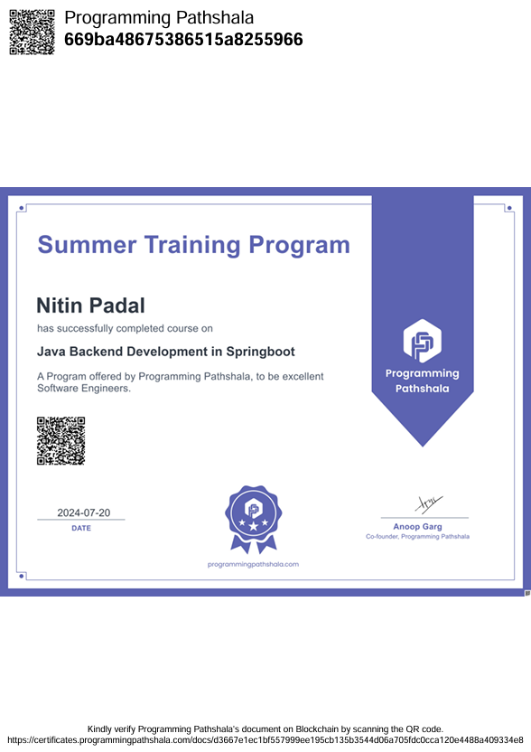

Slide 3
About Summer Training :
We followed a structured methodology for our 8 Weeks Summer training Program by Programming Pathshala for Java backend development in SpringBoot
Which starts from Core Java and OOPS Fundamentals to Advanced Java Concepts, Maven: build automation tool, Core Spring Boot Concepts
And at the end prepared a Well planned mini Project, The goal of this project is to build a powerful REST API that handles student data management. The API will enable creating, reading, updating, and deleting student records, with an interactive HTML front-end for testing and verification. Any changes made through the API will be instantly reflected on the web page.

Slide 4
Overview of Summer Training Program
1
Core Java
Learn the fundamental concepts of Java programming, including variables, data types, control flow, and object-oriented programming.
2
Advanced Java Concepts
Explore advanced topics like collections, generics, multithreading, and exception handling.
3
Spring Boot
Master the Spring Boot framework for building robust and scalable web applications, including REST APIs, data persistence, and security.
4
Project Development
Apply your newly acquired skills by building a real-world project: a student management system with a REST API and a user-friendly front-end.

Slide 5
About Programming Pathshala
With the idea of imparting programming knowledge, Mr. Anoop Garg who taught 10,000+ students through on campus workshops and online courses on Interview Preparation. He has worked at Amazon with its High Scale Systems for three years after graduating from IIT. He is loved by his students for his lucid in-depth explanations and ability to make people think through problems.
Programming Pathshala is an organisation focused on making high quality Tech Education accessible, and helping anyone who wants to make it big in tech - get where they want to be. With a 4.9/5Google rating, our IIT trained mentors have taught 20,000+ students, and enabled them to be high in demand tech professionals.

Slide 6
Why is this Training Important?
Industry Relevance
Career Prospects
Security & Efficiency
Spring Boot is widely used by top companies across various industries, making it a highly sought-after skill.
Backend development using Spring Boot offers a wealth of job opportunities with competitive salaries and growth potential.
Learn to build secure and scalable backend systems, capable of handling complex applications and data management challenges.

Slide 7

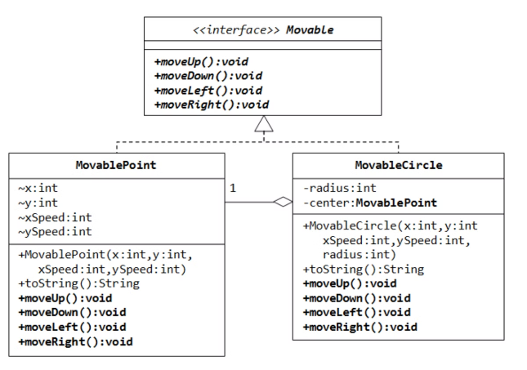
Core Java & OOP Fundamentals
1
Classes and Objects
Represent real-world entities in code
2
Inheritance
Reuse code through parent-child relationships
3
Polymorphism
Multiple forms of methods or operations
4
Abstraction & Encapsulation
Hide implementation, protect data

Slide 8

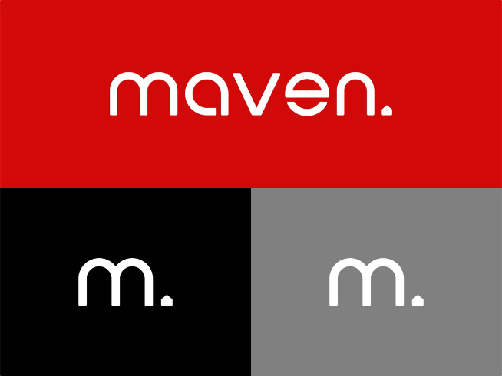
Maven: Build Automation Tool
1
Simplifying the Build Process
Maven automates build tasks
2
POM Files
Add dependencies with the Project Object Model
3
Running Maven Builds
Run builds directly from your IDE
4
Real-Time Projects
Use Maven with Spring Boot MVC, REST API, and Hibernate/JPA

Slide 9


Core Spring Boot Concepts
What is Spring Boot?
Spring Boot Initializer
REST API Controller Development
Simplifies Java web app development
Quickly generate Spring Boot projects
Build simple REST APIs with Spring Boot

Slide 10
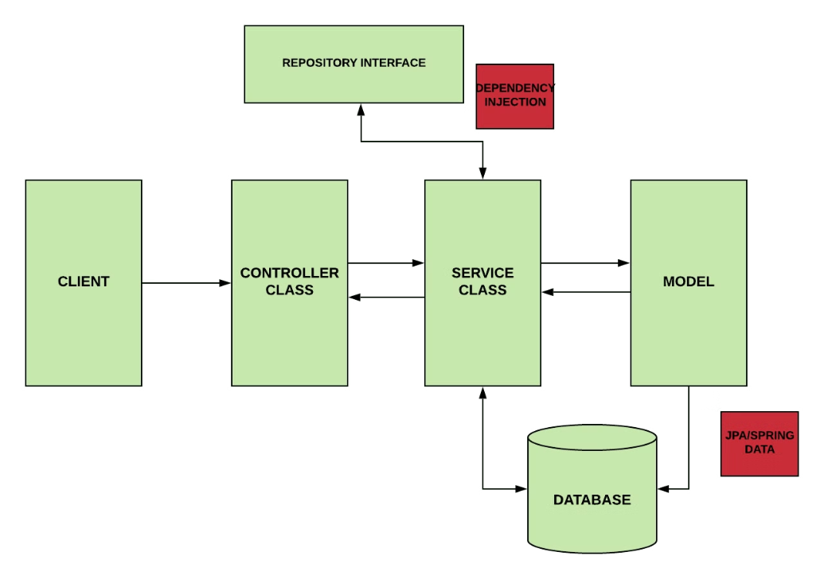
Exploring Spring Boot Project Structure
src/main/java
Contains Java code
resources
Holds configuration files, static content

Slide 11
Project description:
The goal of this project is to build a powerful REST API that handles student data management. The API will enable creating, reading, updating, and deleting student records, with an interactive HTML front-end for testing and verification. Any changes made through the API will be instantly reflected on the web page, allowing for a seamless integration between the backend logic and the frontend presentation.

Slide 12




Student Management System Project
Data Persistence
CRUD Operations
Utilize databases like H2 or MySQL to store student records efficiently.
Implement create, read, update, and delete operations on student data through the REST API.
RESTful API
Front-End Integration
Design a RESTful API with well-defined endpoints for managing student information.
Develop a user-friendly front-end to interact with the API, allowing users to view, add, modify, and delete student data.

Slide 13





Development Process for the Project
Project Setup
Initialize a Spring Boot project and configure the database connection, ensuring the right dependencies are included.
Model Design
Create a Student entity class that maps to the database, utilizing JPA annotations for defining the structure and relationships.
Repository Layer
Implement the CRUD operations for the Student entity using the JpaRepository interface, which provides convenient methods for interacting with the database.
Service Layer
Develop the service layer, responsible for handling the business logic and performing complex operations related to student data management.
Controller Layer
Create RESTful endpoints using Spring MVC controllers, defining the routes and methods for accessing and managing student data through the API.

Slide 14
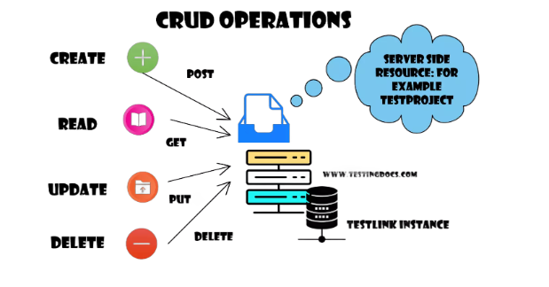




Project Features
Add Students
Read Students
Update Students
Delete Students
Create new student records
Retrieve existing student data
Modify existing student information
Remove student records

Slide 15
Testing & Deployment
1
API Testing
2
Data Synchronization
3
Deployment & Performance
Use tools like Postman to thoroughly test the API, ensuring all endpoints function correctly and return the expected responses.
Verify that the front-end UI updates seamlessly with changes made through the API, ensuring real-time data consistency.
Deploy the application to a server or cloud platform, test for optimal performance, and monitor for any errors or issues.

Slide 16
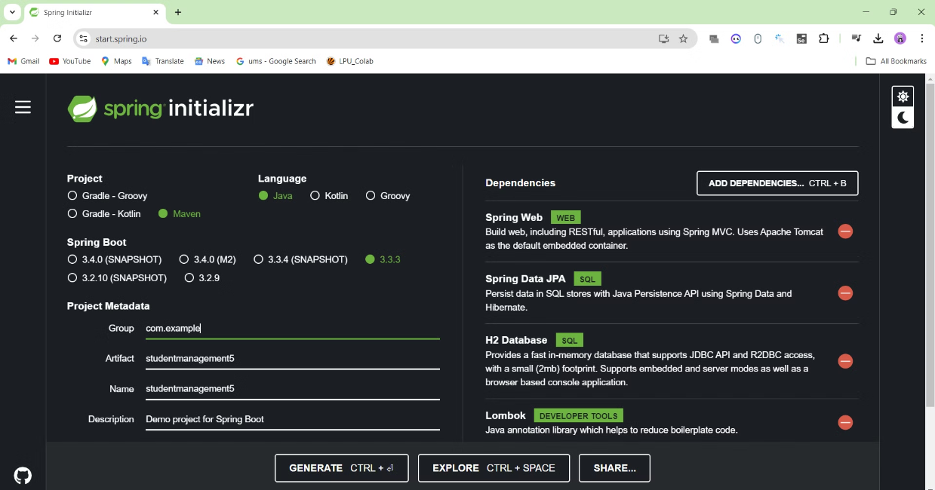
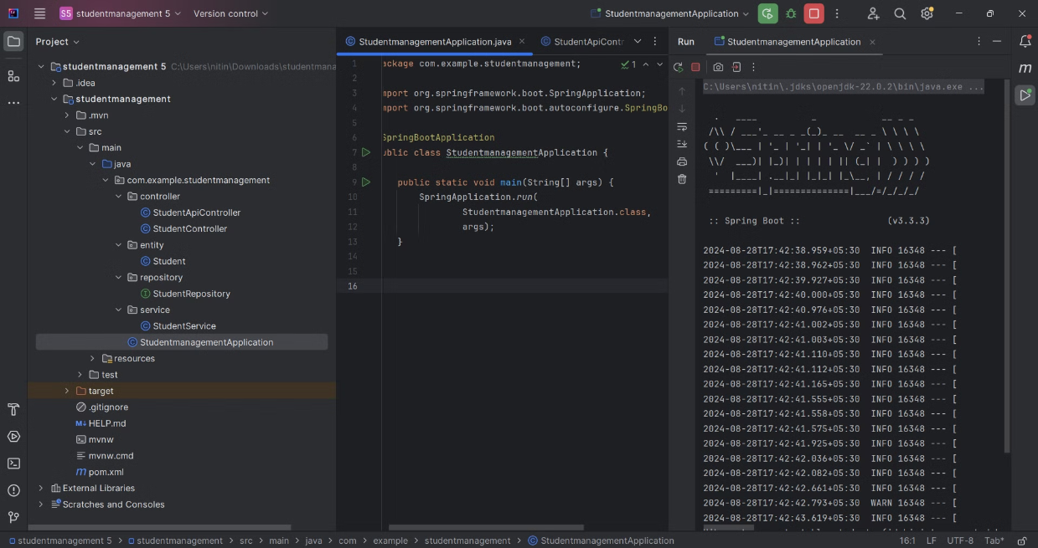

Slide 17
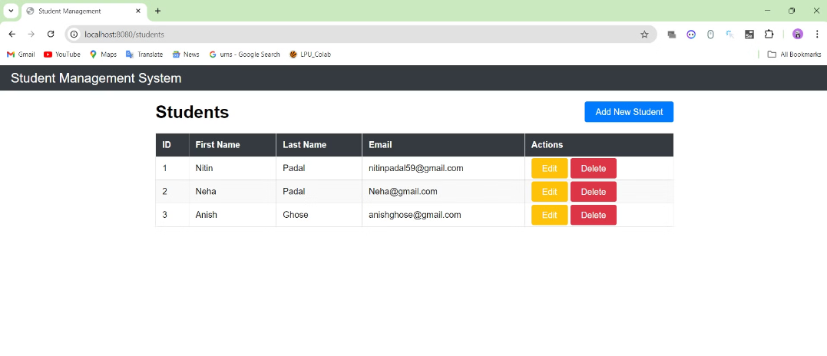
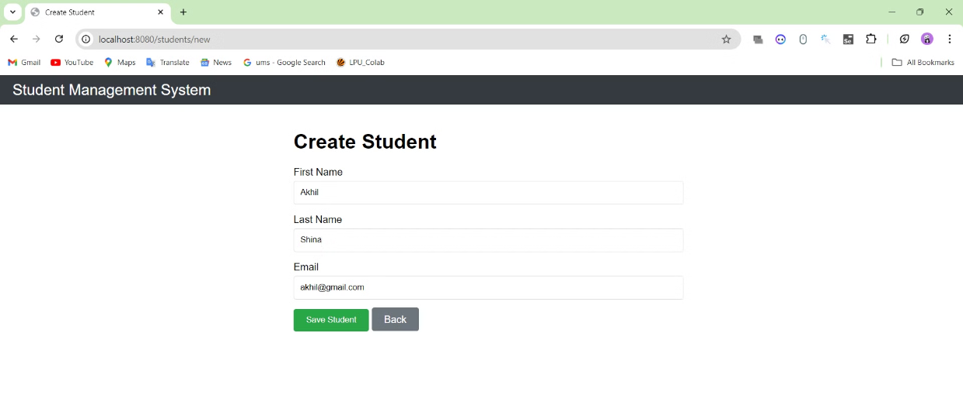

Slide 18
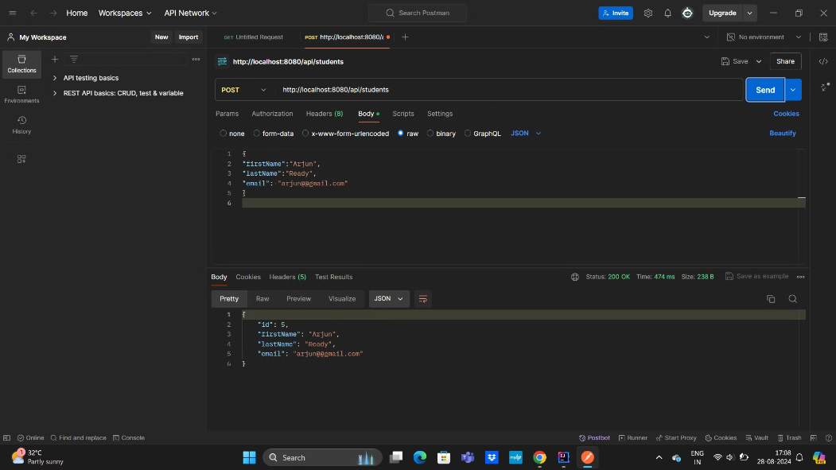
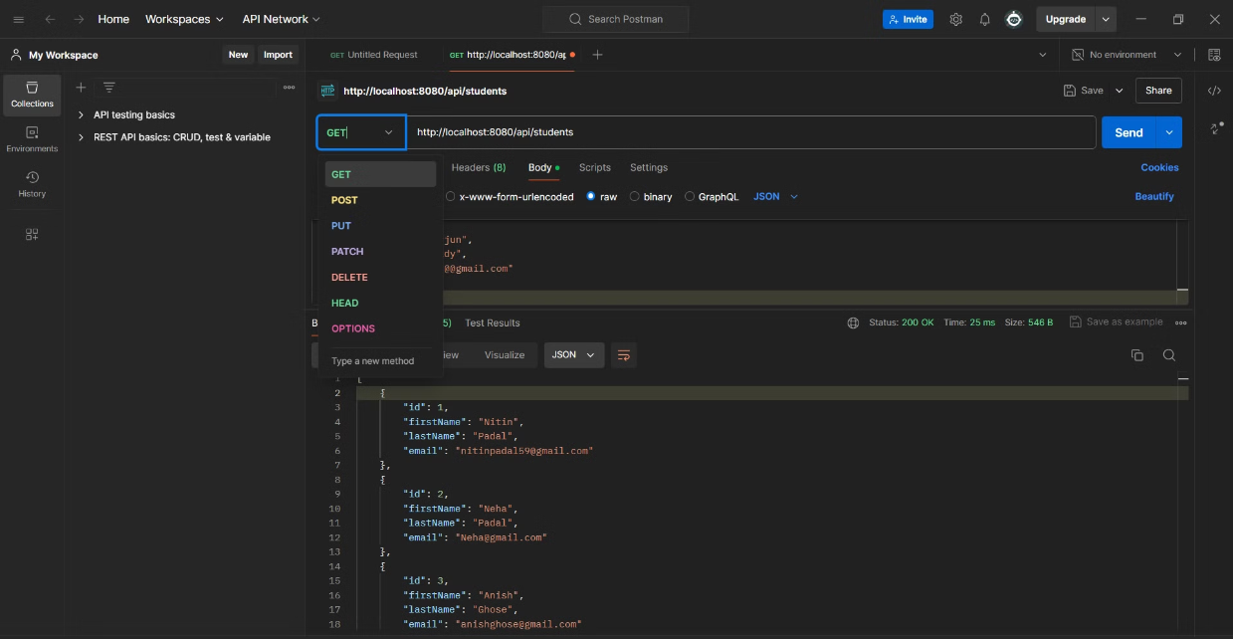

Slide 19
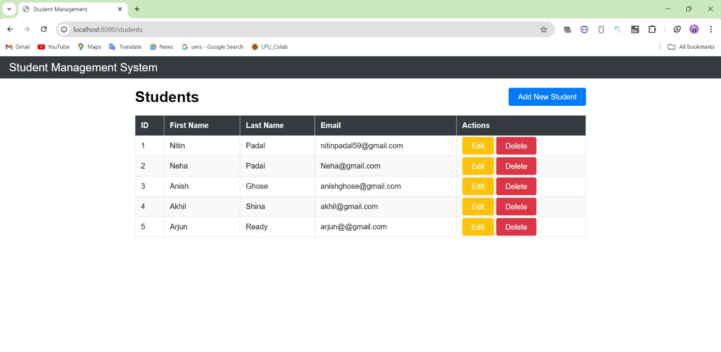

Slide 20
CONCLUSION
In summary, Spring Boot is a powerful framework that simplifies Java application development by providing default configurations and production-ready features. It helps developers focus on building the core functionality of their apps, rather than getting bogged down in low-level setup and infrastructure work.
By using Spring Boot, developers can create flexible and scalable applications that are easy to deploy and run in production environments. The framework's "just run" philosophy and layered architecture make it a great choice for building modern web applications, including powerful RESTful APIs.
Overall, Spring Boot is a valuable tool that can significantly streamline the Java development process and enable developers to build high-quality, enterprise-grade applications more efficiently.

